Slide 1
Truck Platooning System
Distributed and Parallel Systems
Anas Abulehia : 7207091
Joshua Oreoluwa Ademola: 7206750

Slide 2
Content
Introduction
Requirements
Node Architecture
Distributed Architecture
State Diagram
Communication Protocol
Control behaviour
Timing

Slide 3
Introduction
Heavy duty trucks represent about 30% of Carbon dioxide emission in the road transportation sector.[1]
It will increase to 40% in 2030.
Creating an intelligent platooning system can reduce fuel consumption and traffic congestion.[2]

Slide 4
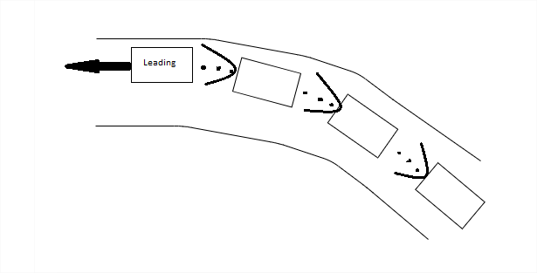
Basic Idea
Leading vehicle, velocity , safe distance, waypoints and steering angle.

Slide 5
Requirements
A maximum of twenty trucks can be in the convoy.
Not more than two small vehicles are allowed between two trucks.
In an intersection, trucks ahead wait for trucks stuck at a traffic light.
Independent adaptive cruise control for each vehicle
Any truck can be swapped to be a leading vehicle
The minimum distance between two adjacent trucks is the distance travelled by the leading truck in four seconds
The maximum distance between two adjacent trucks is 100m.
Column configuration

Slide 6
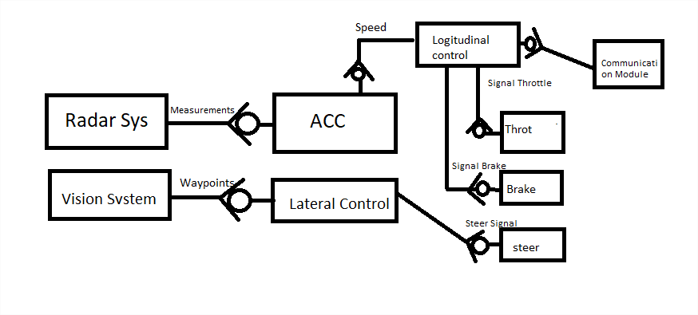
Node Architecture

Slide 7
Node Architecture
Radar System is responsible for measuring speed of objects in front of the vehicle.
Communication Module receives signals for a leading vehicle
ACC control computes needed self vehicle speed to maintain a certain gap between 2 vehicles
Longitudinal Control computes required Throttle and brake for a given velocity it decides which speed to send ACC or received from communication module.
Vision System is responsible for generating waypoints for the vehicle to follow
Lateral control computes required steering input to follow waypoints generated by the vision system.
Radar System, Vision System, ACC, Lateral , and Longitudinal control run concurrently excluding Vision System it requires a separate computer and concurrently integrated with the rest of systems components.

Slide 8
Node Architecture
The System requires simultaneously control vehicle laterally and longitudinally so all the mentioned above components must work concurrently either over several ECUs (Heterogeneous System) or homogeneous ECUs.

Slide 9
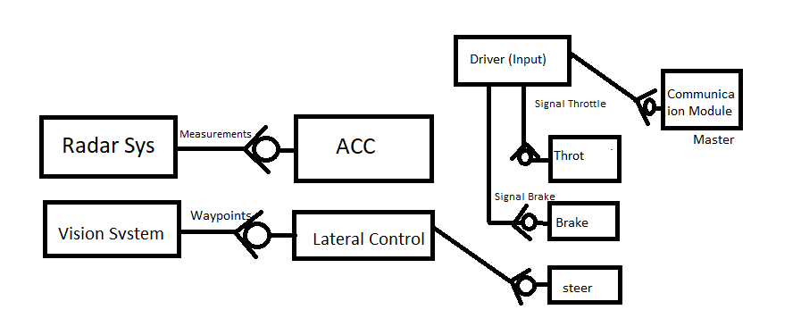
Master Node Architecture

Slide 10
Master Node Architecture
It is very similar to the node, since it can be a non-master node.
The speed is an input signal from the driver or speedometer.
The communication module sends velocity input from the driver to the rest of platoon members.

Slide 11
Distributed system characteristics
Resource sharing: our system implementation does not give access to any of other system elements.
Openness : technically speaking all software part could be implemented in any hardware ECUs and communication module, however the system is not portable since each vehicle has its own different hardware parts(actuators and control) so a careful procedures need to adjust it to fit that vehicle.
Concurrency: real time systems needs a hard deadline so concurrency should take place in algorithm implementations.
Scalability: The design allows ultimate scalability-theoretically- since all processing take place on node elements. (Fat client )
Fault tolerance: it is very crucial, so a validation Algorithm, has been implemented(the idea it not apply functions blindly) coupe with communication failures.

Slide 12
Distributed system characteristics
Security: implementation of authentication of platoon members.
Quality of service is define as how many times data received timely, and safety.
Failure management of any node will not be safe threatening, however this imposes service degradation.
Real time behavior: is a main constraint to the system. A predefined time behavior must be implemented in order to preserve safety and functionality.

Slide 13
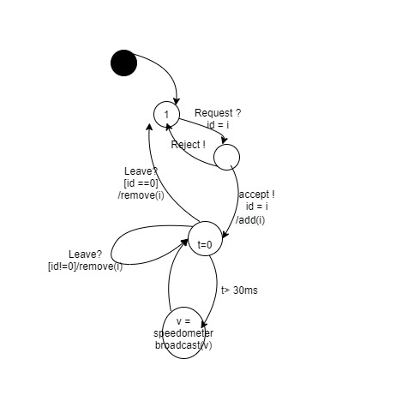
Master State Diagram
It contains logical behavior of master node. It accept nodes requests and sends information to other nodes.

Slide 14
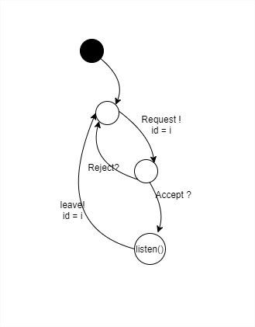
Slave State Diagram
State diagram of slave node, it sends requests and listen to broadcast data.

Slide 15
Communication Protocol
There are several applicable communication protocol for the realization of the system. We have picked our design of the distributed system that involves less computation and simplicity.
The idea is master node specifies the longitudinal speed and each node follow this speed and complete other processes for being in a platoon Lateral signals.
Since all received signals are the same, no required computation for each node MQTT realization is the best fit.
Another realization which includes computing throttle and break is less robust and may require complicated processing.

Slide 16
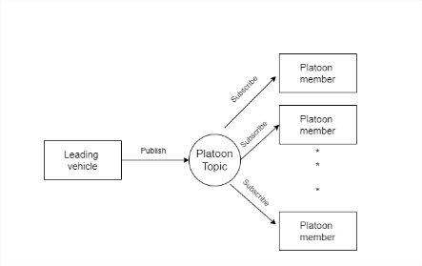
Communication Protocol
MQTT realization of communication Protocol
Model of interaction Is message passing based and each node performs computation based on these messages.

Slide 17
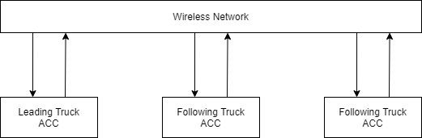
Communication Network Protocol
The network protocol for the platoon is WiMAX (IEEE 802.16).
Range: 5 - 50 km
Latency: 5 - 20 ms

Slide 18
Control behaviour
The distance between two trucks is measure by using a radar between two adjacent trucks.
With a vehicle between two adjacent trucks, the distance is calculated using GPS positions, using the leading truck as the frame of reference.
A differential GPS is used to increase the accuracy
In case of communication failure, each truck drives to a truck stop autonomously

Slide 19
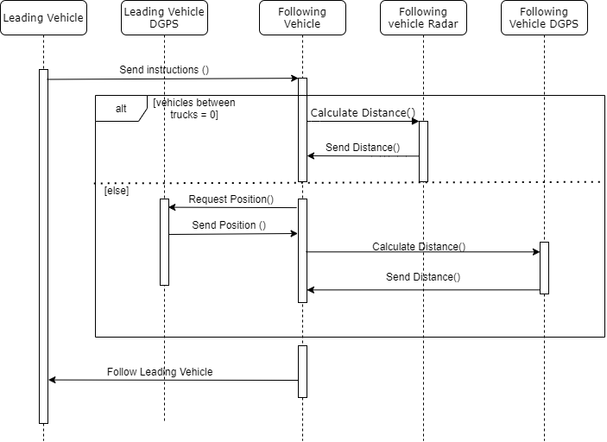
Sequence diagram

Slide 20
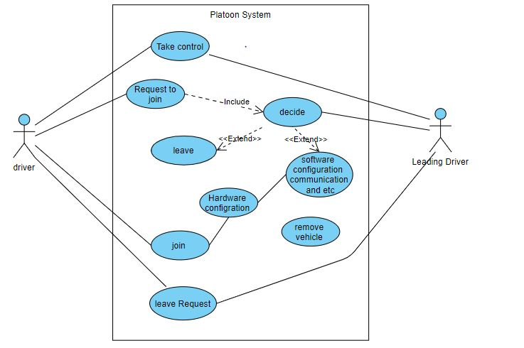
Use case diagram

Slide 21
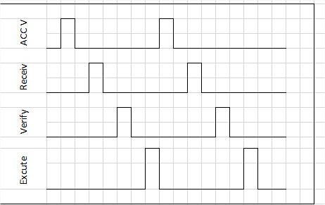
Timing Diagram
Each non-master node performs 4 functionalities.
ACC computes front vehicle speed
It receives a set point speed from master node
It verifies the received speed several condition should be met before sending.(detailed in the paper)
Excute the speed, either ACCv or recived speed .
Each step is 3ms (ie)
Notes:
The condition are no big difference betewen ACCv and received set point,
Recieved setpoint speed timely. Unreasonable values of received speed will be ignored (safety feature)

Slide 22
Time protocol and Clock synchronization
GPS (Global Positioning System) is used as the main system for timing and for clock synchronization.
Physical clocks (quartz) is used as a backup mechanism
NTP (Network Time Protocol) is used for clock synchronization between the different trucks in the platoon
MongoDB is used to time-stamp data

Slide 23
Programming and Hardware
APP4MC (Application Platform Project for Multi- and Many-Core Systems)
ARM CORTEX-A65AE

Slide 24
Reference
[1]. Too big to ignore - truck CO₂ emissions in 2030. By transportenvironment.org
[2]. System Architecture in a Heavy Duty Vehicle Platooning System using xPC TargetTM . Carl-Johan Elm

